Slide 1





Job
Application MARKET
TEAM GLOBAL:
Sandhya Karki Sajan Kumar Kar
Neelima Puthanveetil Sai Pavan Kumar

Slide 2

GOALS
01
Understanding Employability Factors:
To gain a comprehensive understanding of the various factors that influence employability in the tech industry
02
Guidance for Job Seekers
Offer actionable advice to job seekers in the tech industry, helping them understand what factors are most likely to enhance their employability and career development.
03
Empower Companies and Recruiters:
Equip companies and recruiters with data-driven insights to develop more effective and tailored recruitment strategies.
04
Mental Health and Career Outcomes
Explore the potential impact of mental health on career progression and salary, particularly in the context of the tech industry.
05
Predicting employbility
Utilize data-driven models to accurately forecast job applicant success in the tech industry based on key employability factors.

Slide 3



DATASET OVERVIEW
Why did we choose this dataset?
Relevance
Data Quality
Real-World Application:
Provides real-world data from over 70,000 directly aligning with our research domain.
Well-Structured Format:
The data is well-organized, facilitating easy access and interpretation.
Diverse Metrics:
Includes essential metrics like employment status, education level, and more, offering critical insights for our study.
Easy Cleaning and Pre-processing:
Demonstrates high data cleanliness and standardization, simplifying the pre-processing steps.

Slide 4

DATASET OVERVIEW
About the Dataset
73,000+
records
15 columns in total
7
8
integer-type columns
char-type columns
index, employment, yearscode, yearscodepro and previoussalary, computerskills, employed
age, accessibulity, edLevel, gender, mentalHealth, mainBranch, country, haveWorkedWith,

Slide 5

FEATURES OF THE DATASET
Index
Edlevel
Age
the count/unique identifier for each record (1, 2, 3 ...) (integer)
education level of the applicant (Undergraduate, Master, PhD…) (categorical)
age of the applicant, >35 years old or <35 years old (categorical)
Gender
PreviousSalary
ComputerSkills
Employed
gender of the applicant, (Man, Woman, or NonBinary) (categorical)
the applicant's previous job salary (float)
number of computer skills known by the applicant (integer)
target variable, whether the applicant has been hired (categorical)
Some of the type of columns and their description (page 1)

Slide 6
FEATURES OF THE DATASET
HaveWorkedWith
MainBranch
YearsCode
Accessibility
the technical skills of the applicant (C++, Python, Git....)(string/ categorical)
whether the applicant is a professional developer (categorical)
how long the applicant has been coding (integer)
if the applicant has any accessibility needs. (Yes or No)
(categorical)
Employment
Country
YearsCodePro
Mental Health
if the applicant is currently employed (0 meaning No and 1 meaning Yes)
(integer)
the country of the applicant. (US, Canada etc) (categorical)
how long the applicant has been coding in a professional context, (integer)
if the applicant have any mental health issues. denoted by “Yes” or “No” (integer)
Some of the type of columns and their description (page 2)

Slide 7

DATA CLEANING
Missing and Duplicate Check
Numeric Feature Processing
Character Feature Processing
Outlier Detection and Removal

Slide 8
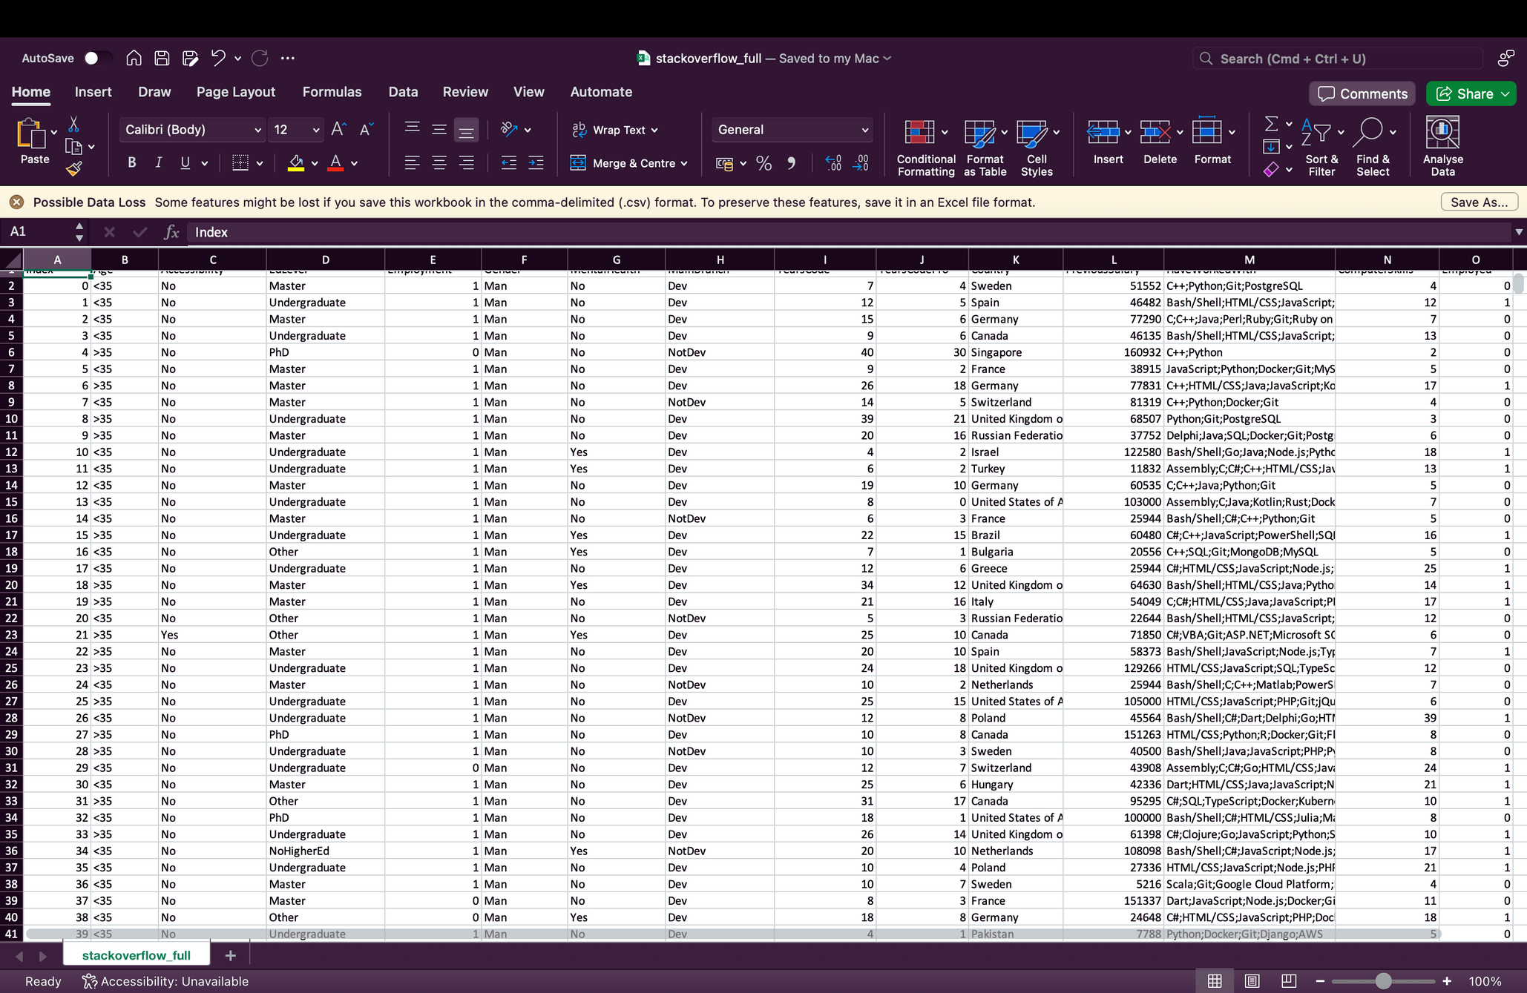
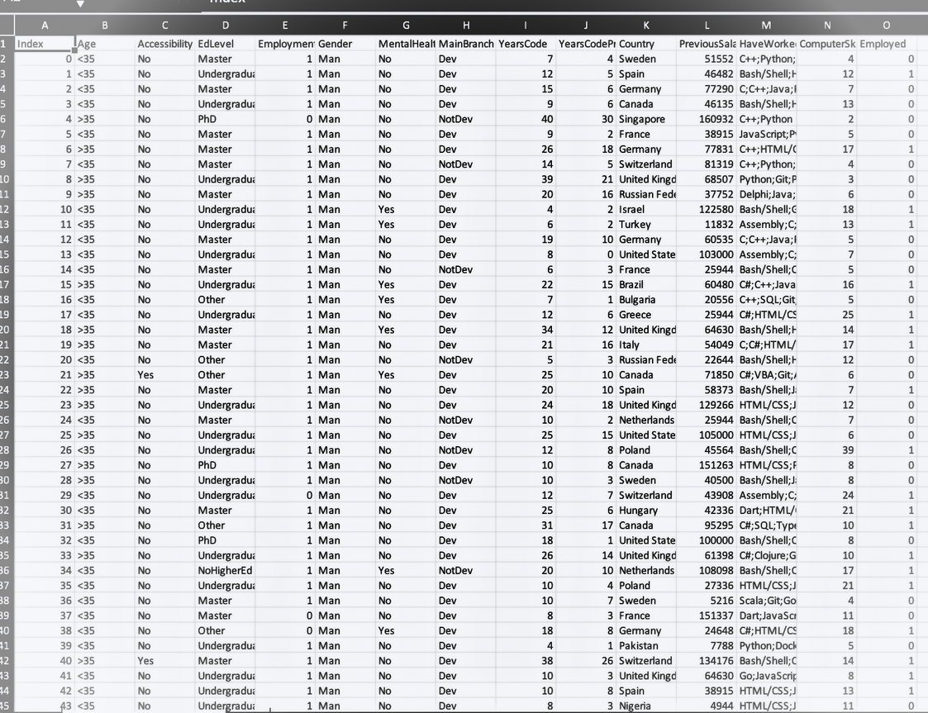
ALL MISSING RECORDS | 0
DUPLICATE RECORDS | 0

Slide 9


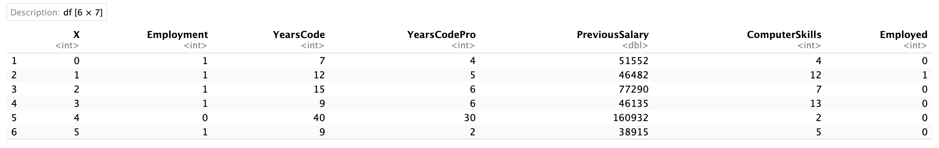
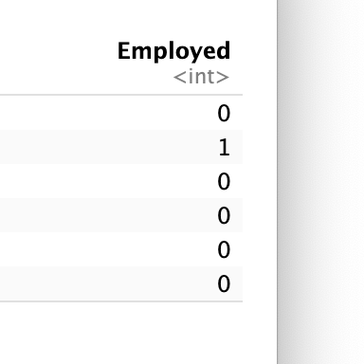
The provided R code transforms the "Employment" and "Employed" columns in the dataframe
"df_clean." It converts numeric values to descriptive categories, enhancing interpretability for analysis.
The resulting factors are "currently_employed" or "not_currently_employed" for "Employment" and "hired" or "not_hired" for "Employed."

Slide 10

if there is data where their professional coding experience is more than their coding experience, we have to remove it because that's faulty data.

Slide 11
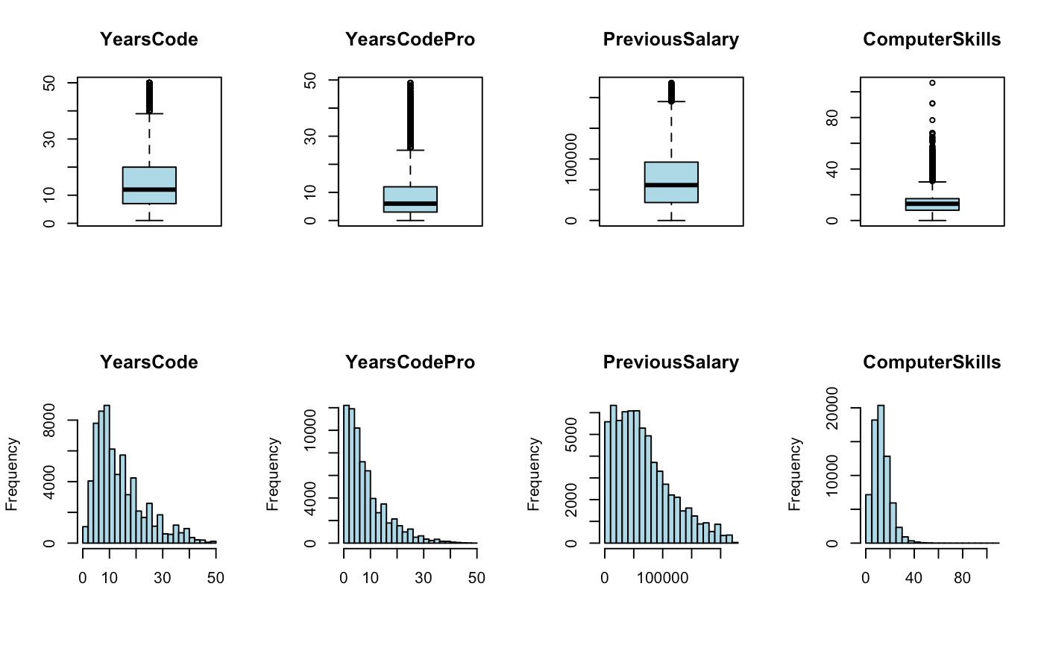

OUTLIERS

Slide 12
EDA
Exploratory data analysis
+
HYPOTHESIS
TESTING

Slide 13
SMART Q1:
Is there a significant difference between employed males and non-males in their respective education levels?

Slide 14
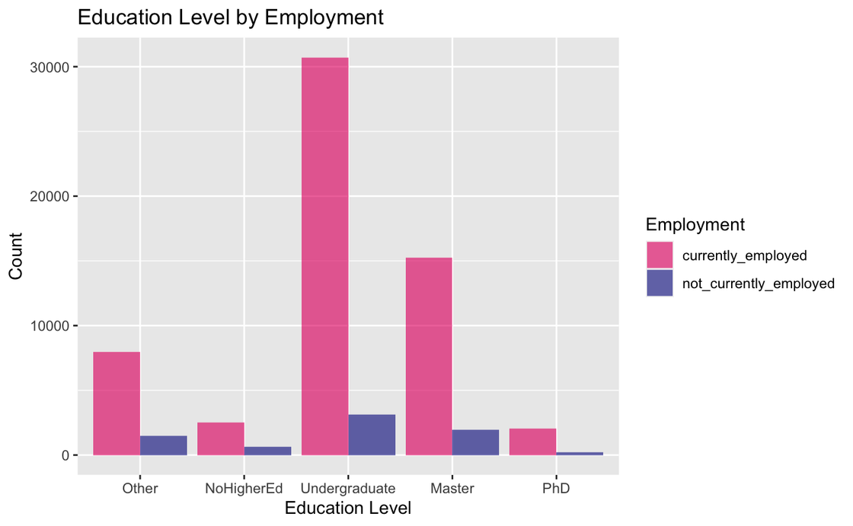
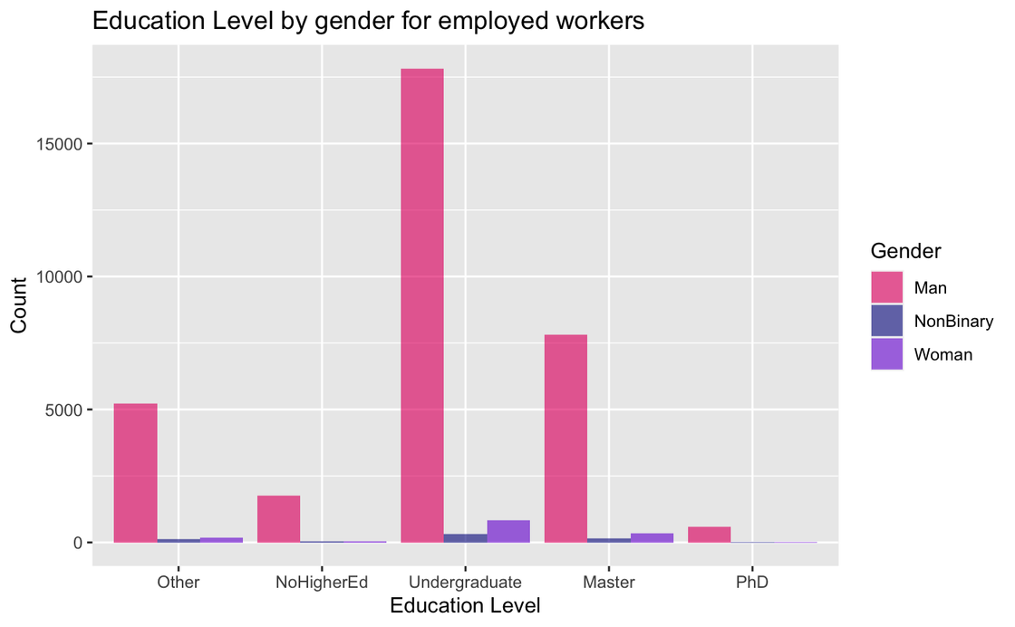

Slide 15
SMART Q1: HYPOTHESIS TESTING
TWO PORPORTIONS Z TEST
H0: THERE IS NO DIFFERENCE IN THE NUMBER OF UNDERGRADUATE MALES WHO ARE EMPLOYED WHEN COMPARED TO NONMALES
H0: THERE IS NO DIFFERENCE IN THE NUMBER OF MALES WITH A MASTER’S DEGREE WHO ARE EMPLOYED WHEN COMPARED TO NONMALES
H0: THERE IS NO DIFFERENCE IN THE NUMBER OF MALES WITH A PHD WHO ARE EMPLOYED WHEN COMPARED TO NONMALES
HA: THERE IS A SIGNIFICANT DIFFERENCE IN THE NUMBER OF UNDERGRADUATE MALES WHO ARE EMPLOYED WHEN COMPARED TO NONMALES
HA: THERE IS A SIGNIFICANT DIFFERENCE IN THE NUMBER OF MALES WITH A MASTER’S DEGREE WHO ARE EMPLOYED WHEN COMPARED TO NONMALES
HA: THERE IS A SIGNIFICANT DIFFERENCE IN THE NUMBER OF MALES WITH A PHD WHO ARE EMPLOYED WHEN COMPARED TO NONMALES
90.72% OF MALES WITH BACHELOR’S DEGREES WERE EMPLOYED
91.39% OF NON-MALES WITH BACHELOR’S DEGREES WERE EMPLOYED
88.45% OF MALES WITH BACHELOR’S DEGREES WERE EMPLOYED
44.46% OF NON-MALES WITH BACHELOR’S DEGREES WERE EMPLOYED
90.64% OF MALES WITH BACHELOR’S DEGREES WERE EMPLOYED
89.50% OF NON-MALES WITH BACHELOR’S DEGREES WERE EMPLOYED
P-VALUE: .2951
P-VALUE: < 2.2X10^-16
P-VALUE: .7119

Slide 16
SMART Q2:
Is an individual’s mental health associated with their previous salary?

Slide 17
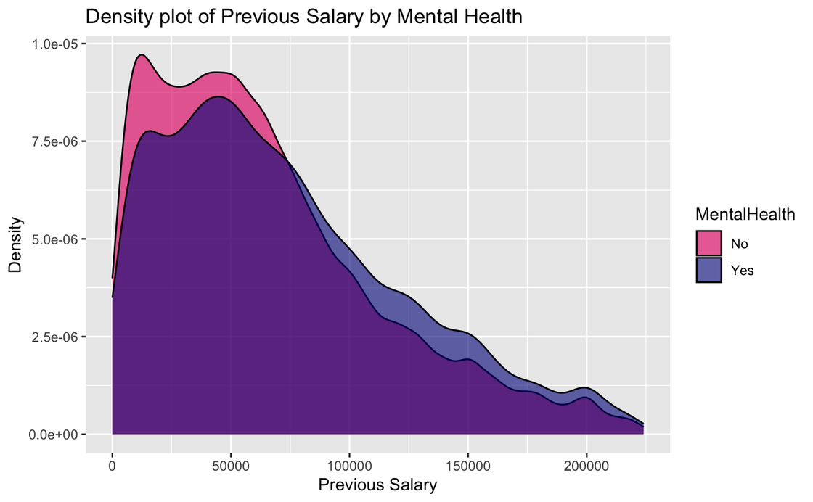
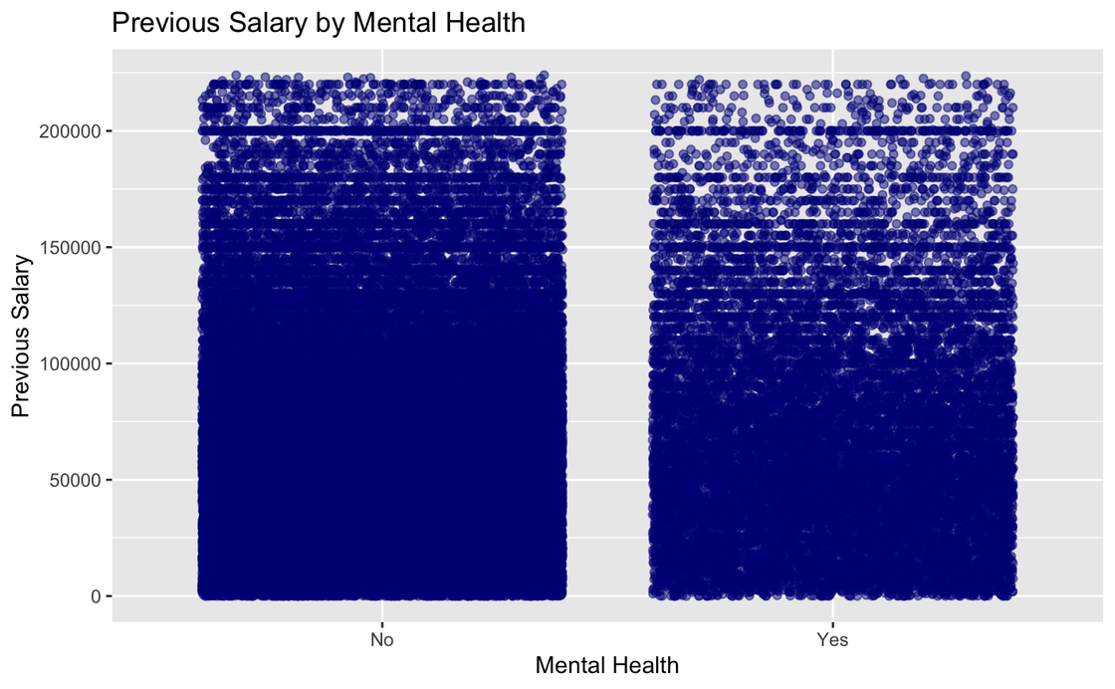

Slide 18

SMART Q2: HYPOTHESIS TESTING
TWO SAMPLE T TEST FOR MEANS
H0: THERE IS NO DIFFERENCE IN MEAN SALARY BETWEEN INDIVIDUALS WHO HAVE AND DO NOT HAVE MENTAL HEALTH ISSUES
HA: THERE IS A SIGNIFICANT DIFFERENCE IN MEAN SALARY BETWEEN INDIVIDUALS WHO HAVE AND DO NOT HAVE MENTAL HEALTH ISSUES
THOSE WHO RESPONDED YES TO HAVING MENTAL HEALTH ISSUES HAD A MEAN SALARY OF $72,709
THOSE WHO RESPONDED NO TO HAVING MENTAL HEALTH ISSUES HAD A MEAN SALARY OF $64,652
P-VALUE: < 2.2X10^-16

Slide 19
MODEL BUILDING

Slide 20





DATA PREP:
ENCODING
MAIN BRANCH
MENTAL HEALTH
ACCESSIBILITY
EMPLOYMENT
EDLEVEL
AGE
COUNTRY
HAVEWORKEDWITH
GENDER
[YearsCode, YearsCodePro, PreviosSalary, ComputerSkills]
The numerical features were standardized. No class imbalance in target variable.

Slide 21




MODELS
LOGISTIC REGRESSION
LR: 87.2%
3-NN: 49.6%
SVM: 78.4%
DT: 78.3%
-NEAREST NEIGHBOURS
AUC-ROC
SUPPORT VECTOR MACHINE
DECISION TREE CLASSIFIER
Oddly, Decision Tree determined based on just `ComputerSkills`

Slide 22
SMART Q3:
Can we predict with at least 60% accuracy whether an individual will be employed or not, based on just their Age, Education Level, and, Number of skills?

Slide 23

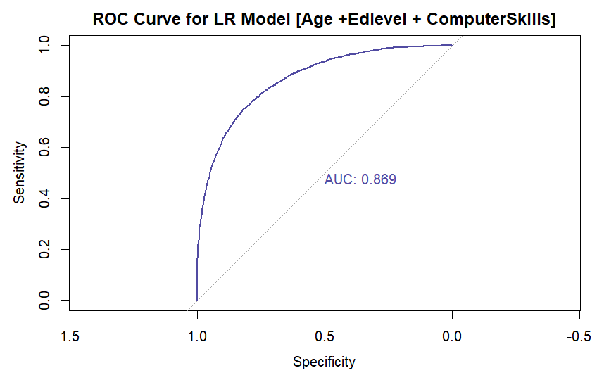

Slide 24
SMART Q4:
Is there a notable difference between distance-based models and tree-based models?

Slide 25

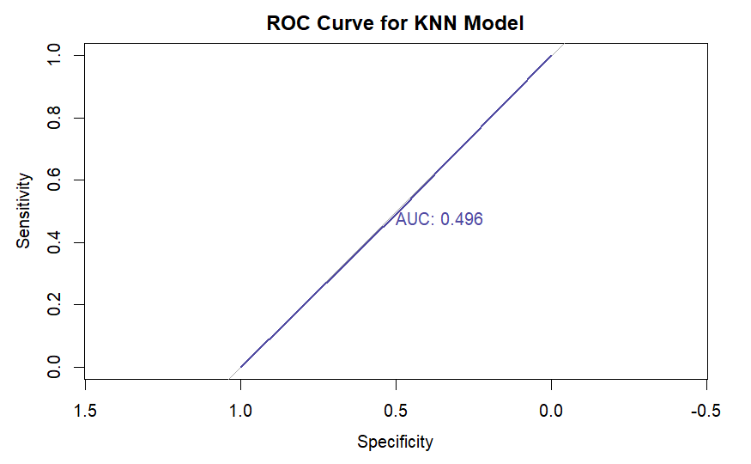
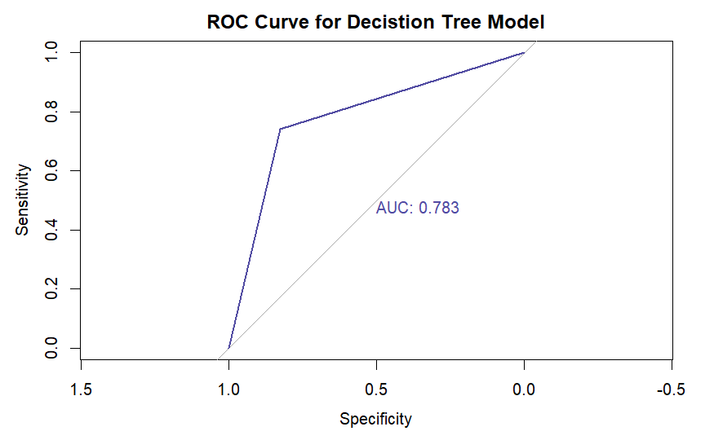

Slide 26

CONCLUSIONS
Come to us!! We will tell you if you’ll get a job or not?
Consultation Fees: $5.99

Slide 27


THANK YOU!

